Slide 1
Operating Systems
Grade 12 CAT

Slide 2
The operating system (OS)
This is the most basic yet fundamental software.
Without it the modern computer user is powerless but we are so used to working in its environment that we take it for granted.

Slide 3
In computing, your application and utility programs have to have a platform from which they can perform.
That platform is your Operating System.
It is an interface between the Software and the hardware
It is the most basic component allowing you to work with your computer programs.

Slide 4
Its job is to make life easier for an uninitiated user as it hides the complexities of the hardware
It is responsible for getting the computer going
It manages resources and programs
Without it users would have to be able to program everything from scratch

Slide 5
Windows is a Graphic User Interface (GUI)
Other operating systems include:
Linux
Unix etc

Slide 6
Functions of an Operating System (OS)
Provide a user interface
Manage the files and folders.
Manage the programs on the computer.
Get hardware ready for use.
Manage the memory of the computer.

Slide 7
Multitasking
The ability of a computer to do several applications at once. For example I can type a document while listen to music. I can also send a large document to the printer while typing another document and still listen to music.
It also means that I can have several programs active at one time and I can swap from one to the other.
However the more I expect from the computer the slower each operation may become.
The OS controls this.

Slide 8
Single users vs. Multiple users
Single user implies one user, one computer, one OS
Multiple user implies many people using a server’s OS seemingly at the same time. In actual fact each user gets a tiny slice of time but has the impression that they are the only users.

Slide 9
Management of files
An OS makes it easy to manage files. File types are distinguished by the file extension. The OS uses the extension to identify how to handle the file. Some examples are:
System | Application
exe → a program | docx → MS Word file
sys → a system file | xlsx → MS Excel file
bat → a batch file | pdf →Portable Document Format file
cmd → command file | pptx → MS PowerPoint file
csv → Comma Separated Value file | accdb → MS Access file
ttf → True Type Font file | txt → Text file
gif → Graphic Interchange Format file | rtf → Rich Text Format file
jpg → Joint Photography Expert Group file | html → HyperText Markup Language file

Slide 10
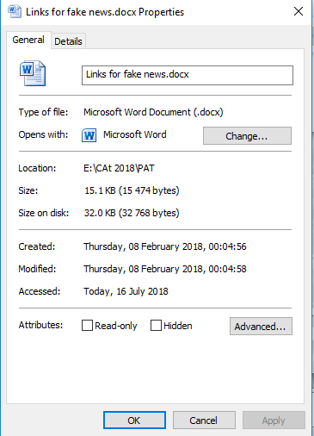
File Properties
To access the properties dialog box right click the required file.
File attributes can be adjusted here or in the program that generated the file.

Slide 11
Metadata
Metadata is basically data about a file. Things like the author, the file size and date are all items that are attached to a file that can be interpreted by an OS.
Metadata attached to a photograph on social media has been used by paedophiles to track locations of children.

Slide 12
Importing/exporting files
The fact that files generated in one application can be used in another application has been made possible by an operating system.
If we pull a file or a portion of a file into an application we import it.
If we send data to another application we have exported it.

Slide 13
Searching
An operating system like Windows allows us to search for files by name, type or date. We can even type in criteria that is in a file (like a word or a phrase) and the OS will speedily search through the items in the specified location.

Slide 14
Conversion
Certain file conversions are possible. For example you can save:
A Word document as a pdf file
A PowerPoint slide as a bmp file
An Excel file as a csv file
Ω

